Slide 1
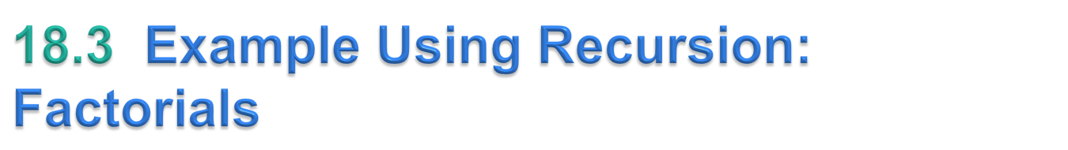
Factorial of a positive integer n, written n! (pronounced “n factorial”), which is the product
  n · (n – 1) · (n – 2) · … · 1
with 1! equal to 1 and 0! defined to be 1.
The factorial of integer number (where number ≥ 0) can be calculated iteratively (nonrecursively) using a for statement as follows:
  factorial = 1;
  for ( int counter = number; counter >= 1; counter-- )
  factorial *= counter;
Recursive declaration of the factorial calculation for integers greater than 1 is arrived at by observing the following relationship:
  n! = n · (n – 1)!
Figure 18.3 uses recursion to calculate and print the factorials of the integers from 0 through 21.
© Copyright 1992-2015 by Pearson Education, Inc. All Rights Reserved.

Slide 2
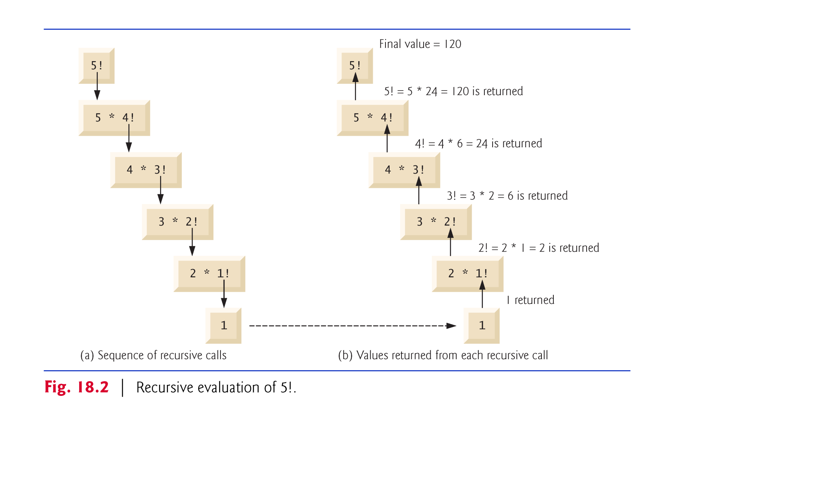
© Copyright 1992-2015 by Pearson Education, Inc. All Rights Reserved.

Slide 3

The Fibonacci series, begins with 0 and 1 and has the property that each subsequent Fibonacci number is the sum of the previous two.
    0, 1, 1, 2, 3, 5, 8, 13, 21, …
This series occurs in nature and describes a form of spiral.
The ratio of successive Fibonacci numbers converges on a constant value of 1.618…,
  called the golden ratio or the golden mean.
The Fibonacci series may be defined recursively as follows:
    fibonacci(0) = 0
    fibonacci(1) = 1
    fibonacci(n) = fibonacci(n – 1) + fibonacci(n – 2)
© Copyright 1992-2015 by Pearson Education, Inc. All Rights Reserved.

Slide 4
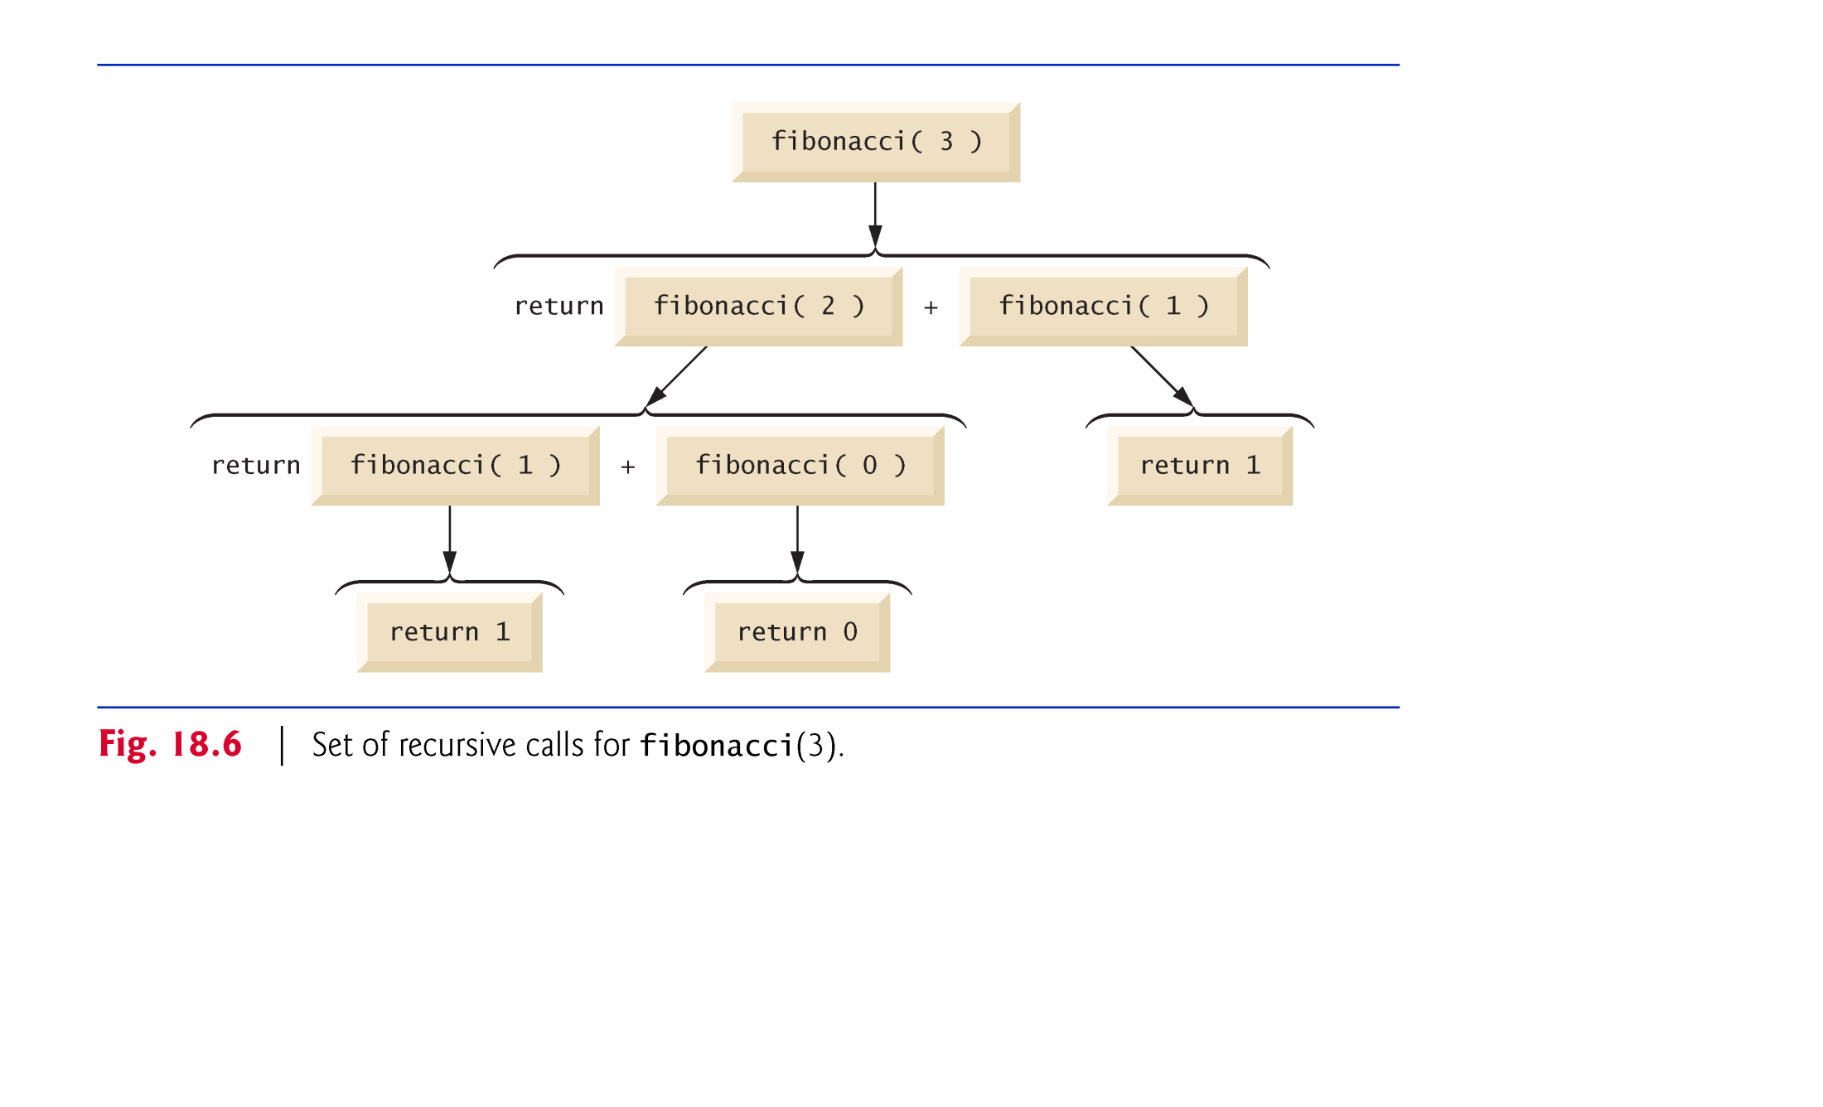
© Copyright 1992-2015 by Pearson Education, Inc. All Rights Reserved.

